Slide 1
NYPD Shooting
Zak Kimball, DTSA 5301

Slide 2
Outline
Background/Data Overview
Data cleaning / missingness
Exploration
Models
Bias

Slide 3
The Dataset
NYPD shooting incidents data
15 years of data from 2006 to 2020
Available on NYC OpenData: https://data.cityofnewyork.us/api/views/833y-fsy8/rows.csv?accessType=DOWNLOAD
Descriptions of variables: https://data.cityofnewyork.us/Public-Safety/NYPD-Shooting-Incident-Data-Historic-/833y-fsy8

Slide 4
Data Cleaning
Data already in a tidy format with each row representing an individual incident.
Minimal clean up required
Set variable classes
Drop unused variables
Missing data

Slide 5
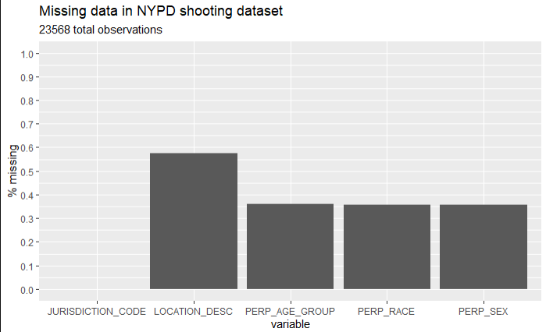
Missing data
Much data missing for location and perp information
16,723 total rows with missing data

Slide 6
Missing data
Two main options to handle the missingness
Impute values:
Missing data not easy to summarize with a heuristic (i.e. use the mean value)
There is likely some non-random factors that influence which data is missing which a model will miss.
Drop the data:
Dropping the missing data will likely lead to some bias.
We decide to drop the missing perp data.

Slide 7
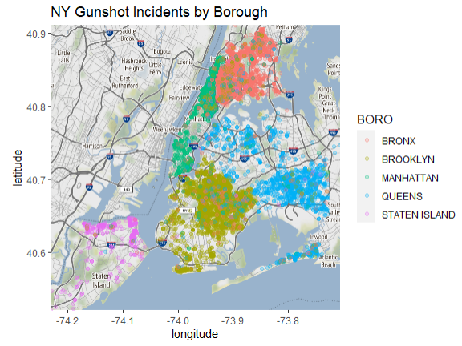
Exploratory analysis
Does the data make sense? Let’s look at a map

Slide 8
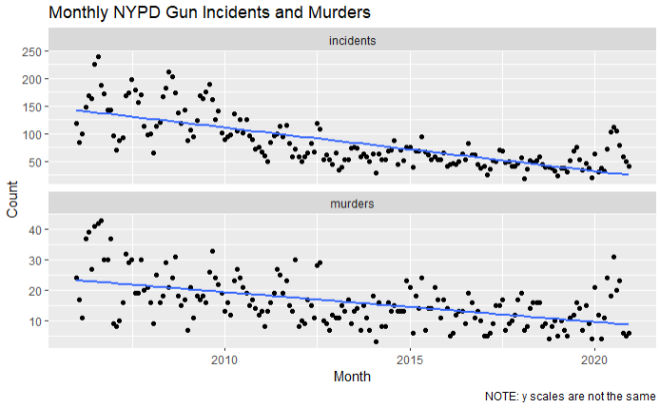
Exploratory analysis
Incidents over time

Slide 9
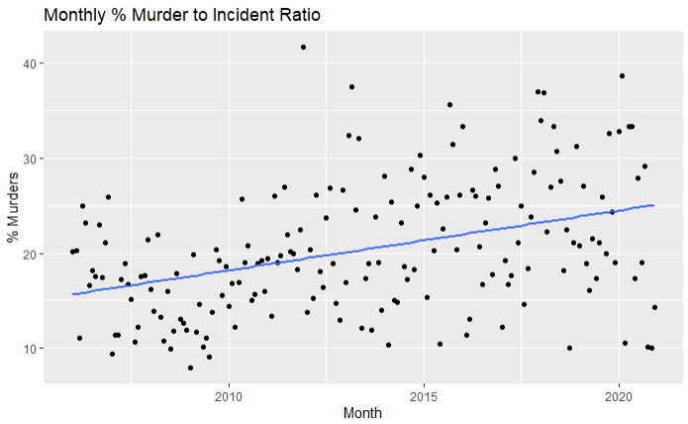
Exploratory analysis
Murder % of incidents over time

Slide 10
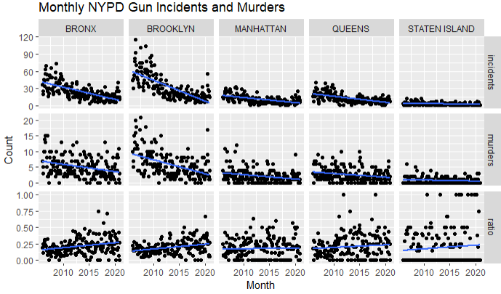
Exploratory analysis
Murder % of incidents over time - by borough

Slide 11
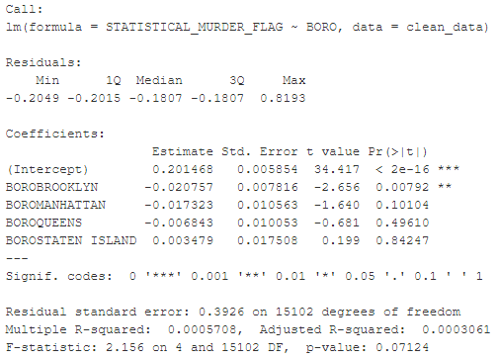
Model
Are lethal shooting more likely in certain boroughs?
Linear model

Slide 12
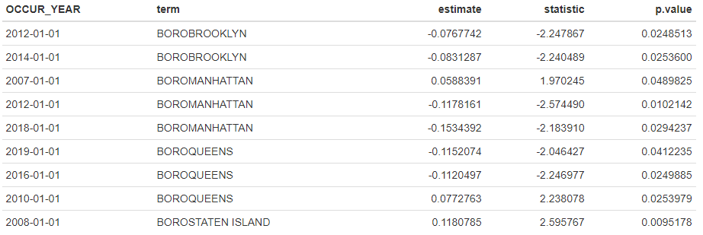
Model
Does the model hold across different years?
Linear models stratified by year
Filter p.values < 0.05

Slide 13
Further questions
How would things change if we add back the missing data?
Do the relationships change if we stratify the data by perp or victim traits such as age instead of by borough?
Does the time of day or day of the week have any effect on what sort of incidents are lethal?
Is there an under reporting or understaffing issue in the NYPD that has caused them to ignore non-lethal gun incidents in more recent history?

Slide 14
Bias
Multiple sources of bias.
Data cleaning: Dropping the rows with missing data likely introduced bias into our data.
Linear models: There are better models for time series and categorical data.

Slide 15
Conclusion
NYPD shooting incidents data
15 years of data from 2006 to 2020
Incidents have steadily decreased over the last 15 years
Murders as a % of incidents have steadily increased.
You are less likely to get shot, but if you do you are more likely to die!

